Slide 1
Police Bot: Enhancing Social Media Governance with Policing Bots
Semester 2 Project Plan Presentation

Slide 2
Overview:
Team Members and Dates
Goal and Motivation
Key Features
Algorithms and Tools
Technical Challenges
System Architecture Diagram
Evaluation
Progress Summary
Milestones
Task Matrix

Slide 3
Team
Team Members:
Cody Manning cmanning2020@my.fit.edu
João Gabriel Silva jsilva2021@my.fit.edu
Liam Dumbell ldumbell2021@my.fit.edu
Nickolas Falco nfalco2021@my.fit.edu
Advisor and Client:
Khaled Slhoub kslhoub@fit.edu
Date(s) of Meeting(s) with the Client for developing this Plan
First Meeting - January 19, 2024
Future Meeting Frequency - Bi-weekly (swapping to weekly and twice weekly as needed)

Slide 4
Goal and Motivation
Bot Detection on reddit.com:
Reddit has Serious Bot problem
Framework aims to:
Detect Bots
Determine Purpose of the Bots (beneficial / malicious)
Generate recommended decisions for each bot
Framework should create a better user experience on Reddit or any other applicable Social Media Platform.
Framework should keep users safe and engaged on the platform

Slide 5
Key Features
Detect Bots
Allow the client to detect artificial users (bots) in a social media platform
Analyzing an account's activity to detect suspicious behavior that would indicate whether or not the account is run by a bot.
Distinguish
Allows the client to distinguish beneficial bots from malicious ones.
A non-harmful bot is one that is determined to have no negative effects on the social media platform in which it is active
A harmful bot is one that is determined to have some form of negative effect on the social media platform it is active on
Decide
Tool will determine the level of maliciousness, and then determining whether reporting the account to the platform administrators is necessary.

Slide 6
Algorithms and Tools
Reddit API
Pulls data from the social media website to perform analysis on
Python
Automate the process of discovering, scanning, downloading, organizing and analyzing Reddit account data.
PRAW Python Library
Interface with the Reddit API
CSV Python Library
Create CSV files filled with Reddit Bot Account information
MySQL Framework
Store data sent to intermediary CSV files on a MySQL database that can be hosted locally or using AWS

Slide 7
Technical Challenges
Continue developing their experience using virtual environments for Reddit and using the Reddit API.
Continue developing their skills creating bots with the proposed functionality.
Continue developing their skills using the libraries and other methods for developing bots for social media platforms.
Continue developing their HTML skills to properly understand and use the different social media APIs.

Slide 8
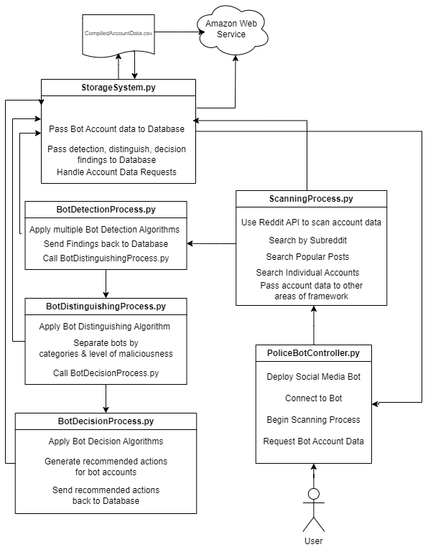
System Architecture Diagram

Slide 9
Evaluation
Speed
Goal to never take longer than 30 seconds to receive data.
Accuracy
80% accuracy goal for correctly detecting bots.
Reliability
Ideally the framework should return with the same result every single time for the same data set.

Slide 10
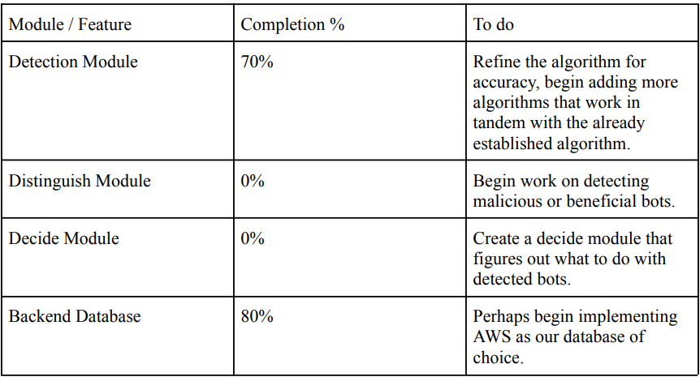
Progress Summary

Slide 11
Milestones
Milestone 4 (Feb 19):
Figure out the next algorithm we want to use to work with the established detection algorithm we already have.
Begin research on how we are going to implement the decide module
Clean up and decide what we are going to do with the database
Try to speed up the current working algorithm for the detection module
Milestone 5 (Mar 18):
Work on the deciding algorithm
Test accuracy and speed of the two modules, particularly the detection algorithm
Combine the two modules into a single framework environment
Create poster and ebook page for Senior Design Showcase
Milestone 6 (Apr 15):
Work on and finish the reporting module
Clean up and merge all of the modules together
Test and bugfix
Demo the framework
Create Demo Video

Slide 12
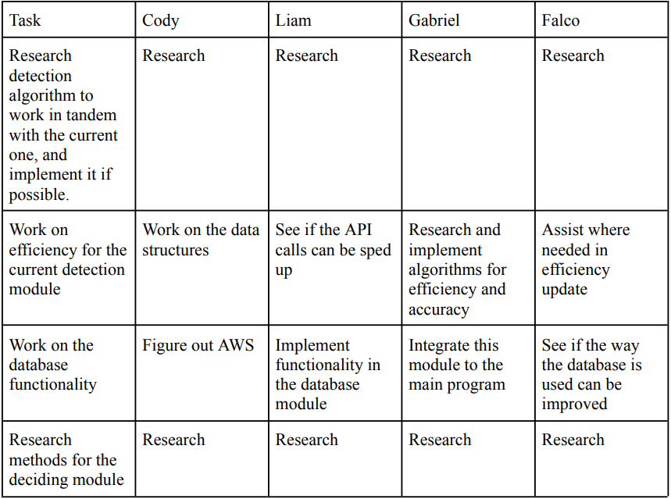
Task Matrix

Slide 13
This concludes our presentation, Thank You

